Slide 1
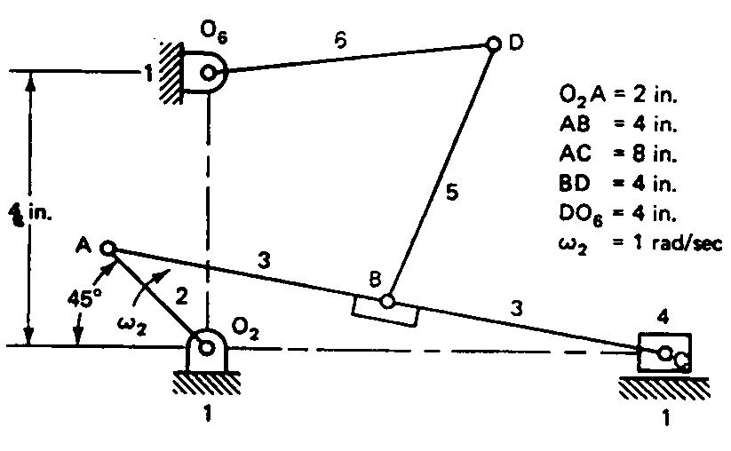
Velocity and acceleration analysis analysis using vectors
Problem 1
Link 2 rotates at a constant angular velocity. Determine the velocity and acceleration of points C and D.

Slide 2
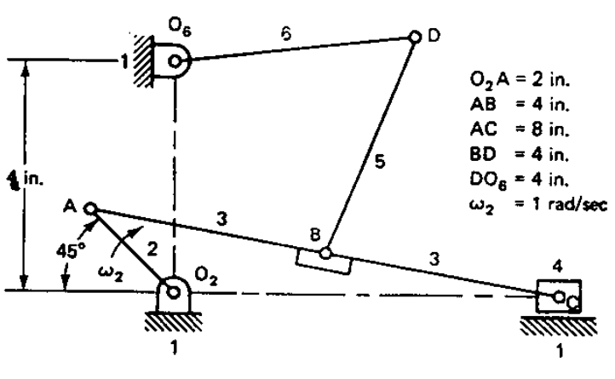
Solution 1 : Velocity analysis for C
V_{C4}=V_{C3}=V_{C3A2}+V_{A2}
V_{A2} = 1 rad/s*2in =2in/s
Normal to link 2
Hence direction and magnitude are both known for V_{A2}
V_{C3A2} is normal to link 3.
Only direction is known
V_{C4}=V_{C3} is horizontal.
Only direction is known
Absolute velocity vectors V_{A2} and V_{C3} start from O_{v.}
Relative velocity vectors never start from O_{v.}
A₂
V_{A2} = 2in/s
D, M
V_{C3A2} =1.45 in/s (approx)
D, M=?
O_{v}
V_{C4}=V_{C3} =1in/s (approx)
D, M=?
C₃
V_{C3A2} =1.45 in/s
Hence
ω₃= V_{D3A2} /AC
=1.45/8=0.18 rad/s
Scale: 1 in=1 in/s

Slide 3
Solution 1 : Acceleration analysis for C
a_{C4}=a_{C3}=a_{C3A2}+a_{A2}=a^{n}_{C3A2}+ a^{t}_{C3A2}+a^{n}_{A2}+a^{t}_{A2}
a^{t}_{C3A2}
Only Direction is known – normal to AC
a_{C4}=a_{C3}
Direction is known - horizontal
a_{A2} = ω²₂* OA
= (1 rad/s)² *2 in=2in/s²
Direction – radially inward along O₂A
a^{n}_{C3A2} = ω²₃* AC
=0.18²*8 in/s²
=0.26 in/s²
Direction- Radially inward along AC
a_{C4}=a_{C3} =1.48 in/s (approx)
D, M=?
O_{a}
C
The vector diagram
a_{A2} = ω²₂* OA
= (1 rad/s)² *2 in =2in/s²
D, M
a^{t}_{C3A2} =1.38 in/s²
(approx)
D, M=?
a^{t}_{C3A2} =1.38 in/s²
Hence
α₃= a^{t}_{C3A2} /AC
=1.38/8=0.17 rad/s²
a^{n}_{C3A2} = ω²₃* AC
=0.18²*8 in/s² = 0.26 in/s² (approx)
D, M

Slide 4
Solution 1 : Velocity analysis for D
V_{B5}=V_{B3}=V_{B3A2}+V_{A2} =V_{B5D6}+V_{D6}
V_{B3A2} = ω₃*AB= V_{D3A2} * (AB/AC)
= 0.18 rad/s*4 in = 0.72 in/s
Normal to link 6.
V_{A2} = 1 rad/s*2in =2in/s
Normal to link 2
V_{D6} is normal to link 6.
Only direction is known
V_{B5D6} is normal to link 5.
Only direction is known
Absolute velocity vectors V_{A2} and V_{C3} start from O_{v.}
Relative velocity vectors never start from O_{v.}
V_{B5D6} = 1.3 in/s (approx)
D, M=?
V_{B3A2} = 0.72 in/s (approx)
D, M
V_{D6} =1.5 in/s
Hence
ω₅= V_{D6} /O₆D
=1.5/4=0.38 rad/s
D
A
V_{D6} = 1.5 in/s
D, M=?
V_{B5D6} =1.3 in/s
Hence
ω₅= V_{B5D6} /BD
=1.3/4=0.33 rad/s
V_{A2} = 2in/s
D, M
B
O_{v}
Scale: 1 in=1 in/s

Slide 5
Solution 1 : Acceleration analysis for D
a_{B5}=a_{B3}=a_{B3A2}+a_{A2}= a_{B5D6}+a_{D6}
a^{n}_{B5D6}+ a^{t}_{B5D6}+a^{n}_{D6}+a^{t}_{D6}=a^{n}_{B3A2}+ a^{t}_{B3A2}+a^{n}_{A2}+a^{t}_{A2}
a^{n}_{D6} = ω²₆* O₆D
= (0.38 rad/s)² *4 in=0.57 in/s²
Direction – radially inward along O₆D
a^{t}_{D6}
Only Direction is known
– normal to O₆D
a^{t}_{B3A2}
Only Direction is known
– normal to AC
a^{n}_{B5D6} = ω₅²*BD = 0.33²*4=0.44 in/s²
Direction – radially inward along BD
a^{n}_{B3A2} = ω²₃* AB
=0.18²*4 in/s²
=0.13 in/s²
Direction- Radially inward along AC
a^{t}_{B5D6} = α₃*AB = a^{t}_{C3A2}*(AB/AC)
=1.38*4/8=0.69 in/s²
Direction – normal to BD
a_{A2} = ω²₂* OA
= (1 rad/s)² *2 in=2in/s²
Direction – radially inward along O₂A

Slide 6
Solution 1 : Acceleration analysis for D
a_{B5}=a_{B3}=a_{B3A2}+a_{A2}= a_{B5D6}+a_{D6}
a^{n}_{D6}+a^{t}_{D6}+a^{n}_{B5D6} + a^{t}_{B5D6} =a^{n}_{A2}+a^{t}_{A2} + a^{n}_{B3A2}+ a^{t}_{B3A2}
Since D cannot be located using the current order of vector addition, locating B is also difficult.
a^{t}_{D6}
D, M = ?
Where is B₃ ?
Where is D₆? Where does a^{n}_{B5D6} begin?
a^{n}_{D6} = 0.57 in/s²
D, M
O_{a}
a^{n}_{B5D6} = 0.44 in/s²
D, M
a^{t}_{B5D6}
D, M
a^{t}_{B3A2}
D, M=?
a_{A2} =2in/s²
D, M
Scale: 1 in =0.5 in/s²
a^{n}_{B3A2} =0.213 in/s²
D, M

Slide 7
Solution 1 : Acceleration analysis for D
a^{n}_{B5D6} = 0.44 in/s²
D, M
a^{t}_{B5D6} = 0.3 in/s²
D, M
O_{a}
Change order of addition of vectors
a^{n}_{D6} = 0.57 in/s²
D, M
a_{A2} =2in/s²
D, M
a^{t}_{D6}
D, M = ?
a^{t}_{D6} = 4.1 in/s²
D, M = ?
a^{n}_{B3A2} = 0.213 in/s²
D, M
a_{B5}=a_{B3}=a_{B3A2}+a_{A2}= a_{B5D6}+a_{D6}
a^{n}_{D6}+a^{t}_{D6}+a^{n}_{B5D6} + a^{t}_{B5D6} =a^{n}_{A2}+ a^{n}_{B3A2}+ a^{t}_{B3A2}+a^{t}_{A2}
a_{B5}=a_{B3}=a_{B3A2}+a_{A2}= a_{B5D6}+a_{D6}
a^{n}_{D6}+a^{t}_{D6}+a^{n}_{B5D6} + a^{t}_{B5D6} =a^{n}_{A2}+a^{t}_{A2} + a^{n}_{B3A2}+ a^{t}_{B3A2}
a^{t}_{B3A2} = 2.8 in/s²
D, M=?
a^{t}_{B3A2}
D, M=?
a_{D} = 4.05 in/s²
Scale: 1 in =0.5 in/s²
D
B

